Slide 1

Hunting Malicious Office Macros
Defcon 30 BTV
By Anton Ovrutsky | 2022

Slide 2
Talk Materials
https://github.com/Antonlovesdnb/BTV30
Notes:
Before I dive in, I wanted to mention that all the materials for the talk including data sets, Sysmon configs and diagrams are available at the Git repo linked in this slide

Slide 3
About Me
Current: Sumo Logic Threat Research
Previous: Lares
Purple Teaming / Hunting / Logs / Queries
Twitter : @Antonlovesdnb

Slide 4
Agenda
Why focus on Macros
Baselining
Hunting
Notes:
Getting to what we’re covering today, I want to briefly go over why a focus on macros is worth your time, worth paying attention to, worth putting engineering hours into
Also want to cover baselining, there’s a lot of talk about baselining activity on the network, but not a lot of guidance on how to actually do it and what the benefits of it are
The final and longest section of the talk will go over some hunting ideas, with particular attention being paid to alerting and detection strategies

Slide 5
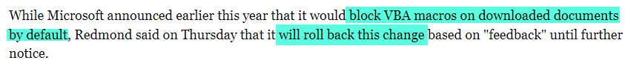
Why Macros ?
Out of 122 Groups tracked by ATT&CK 59 utilize T1024.002
Google: macros site:https://thedfirreport.com/
Microsoft rolls back decision to block Office macros by default (bleepingcomputer.com)
Notes:
So why are we looking at macros so heavily ? Why the big deal?
Doing some number crunching with MITRE ATT&CK data, we can see that about half of the tracked groups utilize the T1024.002 technique which is “Malicious File”
If we dug deeper, I would not be surprised if even more tracked threat actor groups utilize malicious macros in some way or another
Another thing you can do, in order to get a feel for just how often malicious macros are utilized is search for the word macros on the DFIR report. You will see a lot of intrusion write-ups that begin with a malicious macro being used
So, given their prevalence in the threat actor space, combined with the fact that a lot of users live in, and use macros every day, combined yet again with the fact that these settings are not hardened by default on end-user machines; this all creates a dynamic where macros used maliciously begin to pose a lot of risk to your organizations or clients
Of course, I do need to mention that – at least at the time of making these slides – Microsoft is currently backpedaling on some planned Macro hardening changes, which is unfortunate

Slide 6
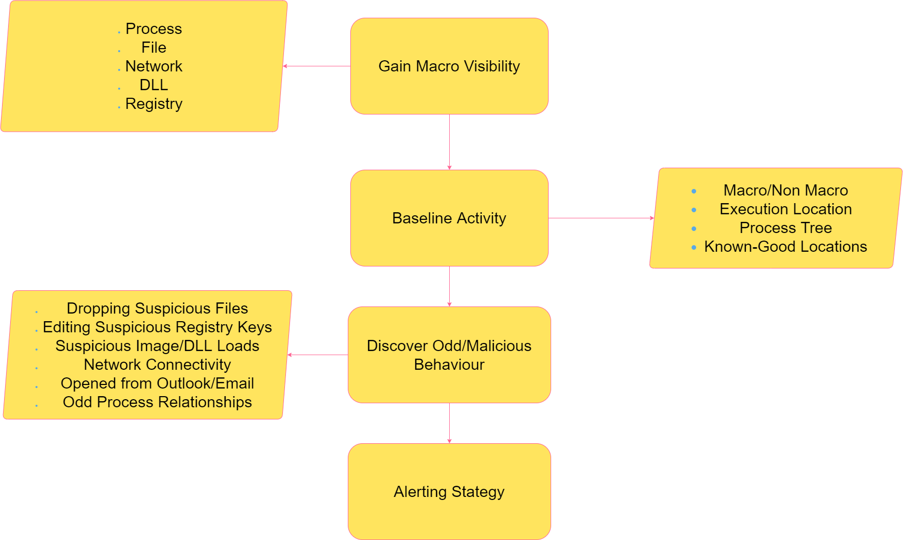
Notes:
Okay, we’ve been scared enough and have decided to do something about this problem, where do we start ?
The graph on this slide represents, what I think, is a decent starting point for beginning to wrangle macro visibility
It should be noted that visibility into macro executions and system hardening done in order to limit unauthorized macros are synonymous – that is, you can’t disable macros for users unless you understand how and where they are used
The next step after gaining visibility into macro executions – and here by visibility, I mean endpoint-level telemetry such as process, file, network, DLL and registry events – is the baseline macro behavior
What does baselining mean exactly and what are you looking for specifically? Things like process trees, known-good locations, where macros are executing from, what are they doing etc
Now, after you’ve gained some visibility and have started to baseline behavior in your environment, you can start to hunt or alert for suspicious activity – this can mean:
The dropping of suspicious files
Editing suspicious registry keys (trusted location, VBA security settings)
Office binaries connecting to odd URLs
Abnormal or unexpected process trees

Slide 7
Baselining Toolbox
OfficeWatch.xml
Utilize to see all Office activity that can be captured via Sysmon
OfficeShush.xml
Filter out the noise that Office applications make, compare to events seen with OfficeWatch.xml
OfficeSus.xml
Add suspicious events to this config for testing, then add to main Sysmon config
Notes:
Rather than just say, go baseline, as part of this talk three different Sysmon configs will be made available in the repo
OfficeWatch.xml shows you everything that Sysmon can capture about Office products
OfficeShush.xml then filters these events out so you can compare and contrast
OfficeSus.xml is an include-only Sysmon config that includes suspicious or suspicious-adjacent activity only
The idea here is that you use these three configurations on a test machine with macros that are benign but behave suspiciously, things like macros that call out to your own testing C2 or Red Canary atomic red team
Flip back and forth between the different configurations until you lock in what you think is abnormal behaviour, then add these entries to your main Sysmon config, or look for the telemetry in your existing tooling

Slide 8
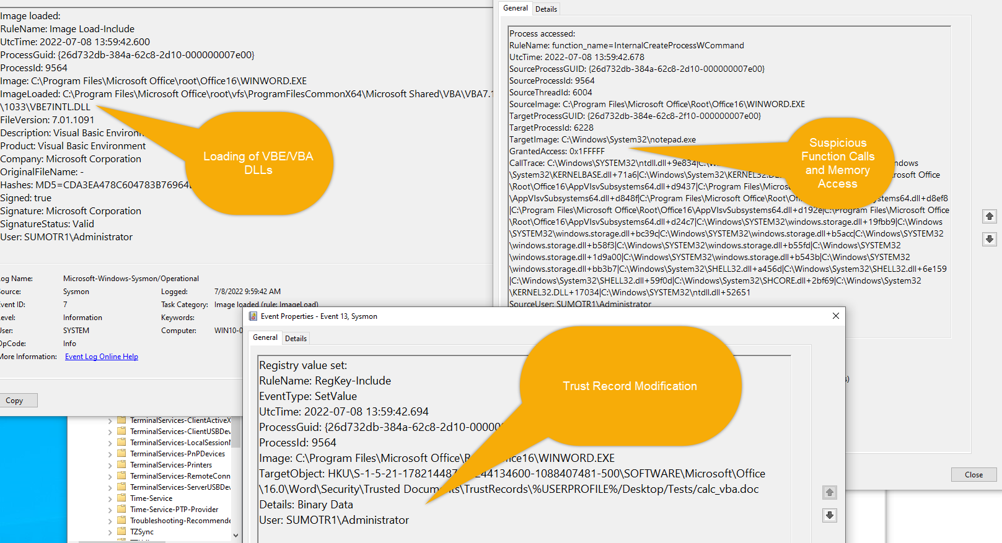
Notes:
Now that we have some visibility into macros, let’s look at some log examples from macro executions – this slide is showing some basic Sysmon events that will tell you that a macro executed, including some suspicious function calls on the top right.
Log examples are great, and these events look cool: we see an interesting call trace with some suspicious memory access and function calls on the top right and we see some registry keys being edited on the bottom as well as a VBE DLL being loaded on the to left – so we have good data and telemetry, now we need to turn this data into something actionable; something that will give analysts or whoever is looking at this information good context and insight into what happened on systems where potentially malicious macros executed.

Slide 9
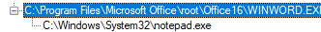
Behavior – Macro Opened from File Share
https://raw.githubusercontent.com/gtworek/PSBits/master/DFIR/Get-SysmonTree.ps1
Grzegorz Tworek (@0gtweet) / Twitter
Notes:
For the next few slides, I’m using the amazingly useful PowerShell script by Grzegorz Tworek that’s linked directly in the slide –
Here, for a very basic example, we are looking at a macro, launched from a file share that opens notepad – I couldn’t get the full command line in the slide, but if you were to look at it it would contain the path of the file that was opened via WINWORD.exe
So just by using process creation events, we can already see things like where macros are being opened from and what processes they are spawning, these are two key pieces of information when making a determination as to whether a particular macro is malicious or benign

Slide 10
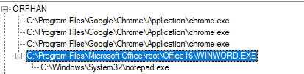
Behavior – Macro Opened From Browser
Notes:
This is a process tree for the exact same macro, opened directly from the browser this time instead of a trusted file share
We can see that just by using process creation events, we can already start to discern macro behavior from something that is probably benign – like opening a macro from an internal file share – versus opening a macro from a web site of some kind.
You can also use this process information, knowing that the macro opened from a website, to do some pivoting to figure out where exactly a particular macro was downloaded from (more on this in some later slides also)

Slide 11
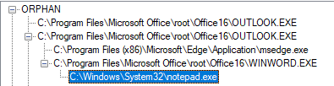
Behavior – Macro Opened As Attachment
Notes:
And looking at one final process tree – this time the macro is opened as an attachment from Outlook
Again just by using process creation data, we can already tell whether a user opened a macro from a file share, as an attachment or from a web site of some kind – very important information to have when conducting an investigation of some kind

Slide 12
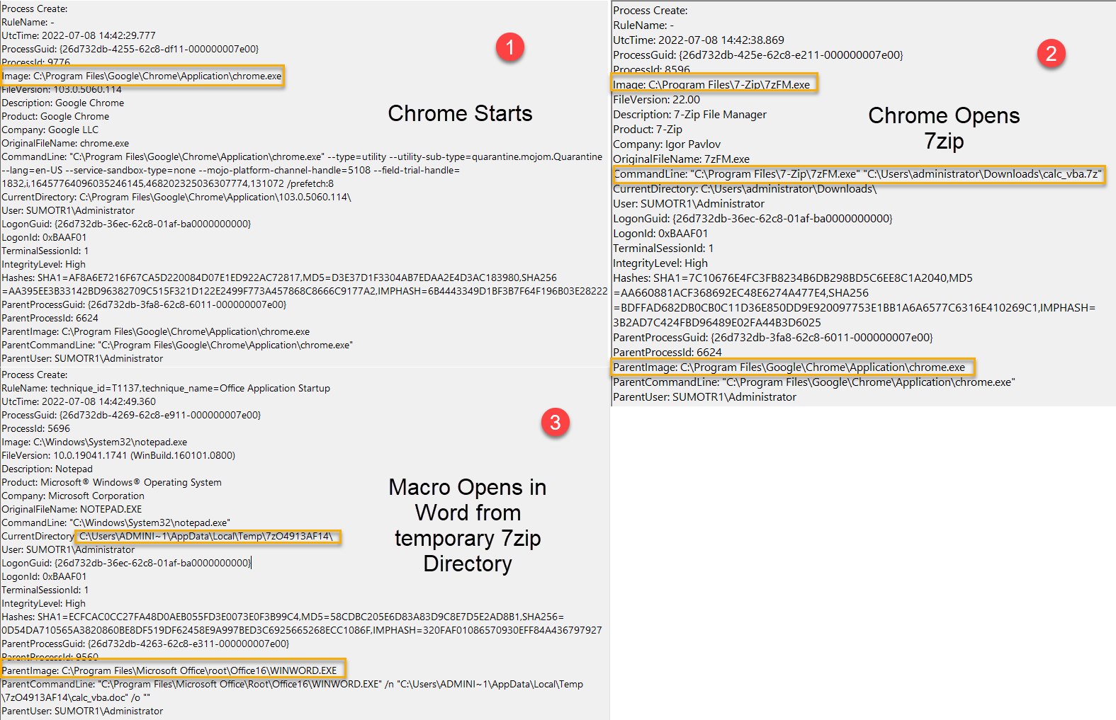
Behavior – Encrypted Zip From Browser
Notes:
Now let’s look at some events that occur when a macro is opened from within an encrypted zip
Since time is a factor here and different applications are involved, it is difficult to build a process tree
I know these screenshots may be difficult to see, but the main point to get across here is that you are able to extract user behavior from telemetry, including how a user interacted with a potentially malicious Office macro – and so far we’ve only looked at process creation events.
So, given hat, let’s broaden our scope a little bit and look at some other interesting event types in the context of office macros

Slide 13
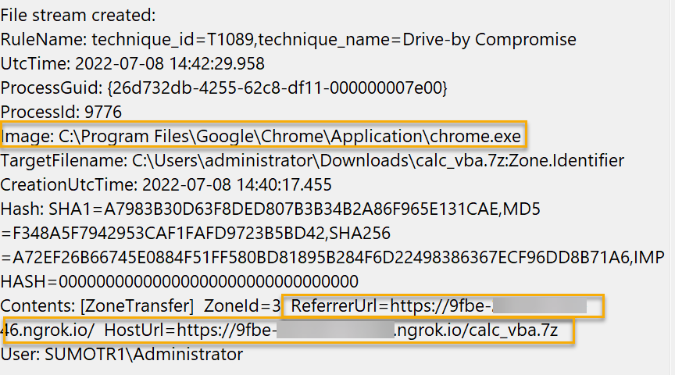
Bonus: EID 15!
Notes:
Using Event ID 15 (File Stream Created) you can see what process downloaded a certain file, and where that file came from
In this screenshot, you can see that my macro, which was found in calc_vba.7z was downloaded from ngrok.io which is a potentially suspicious domain

Slide 14
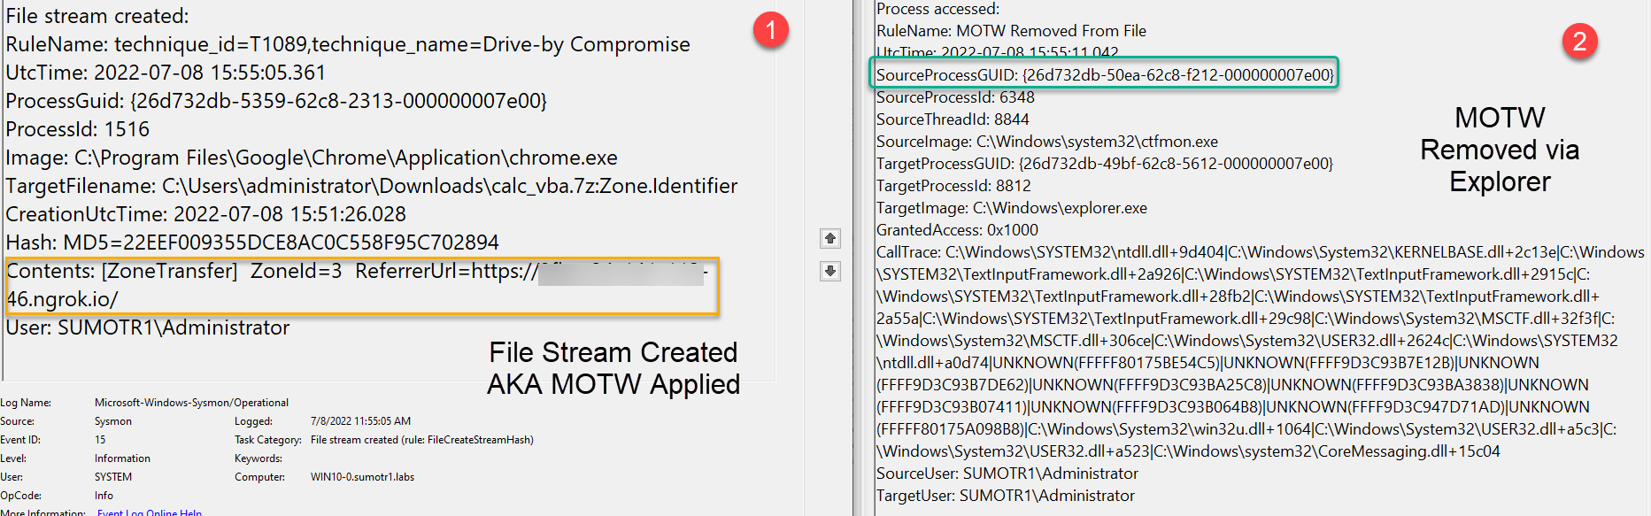
Bonus2: MOTW Removal
Gotchas:
Experimental
PID/GUID is different
Download and MOTW removal may occur minutes / hours apart
Difficult to correlate
Notes:
Some more events to look at in the context of Macros, as I mentioned in the previous slide, if a file is downloaded with a mark of the web, you can see where the file was downloaded from (this is the screenshot on the left is showing (1) )
A full examination of MOTW behavior is out of the scope for this talk as I don’t have time, however, in a typical scenario, a file with a Zone Identifier applied is a “Mark of the web” and a Zone ID of 3 as is shown in the screenshot means the file was downloaded from the internet, so if a user double clicks the file a SmartScreen warning will pop up which the user can click through.
The event on the right hand side – and the Sysmon config snippet required to generate this event is on the Git repo linked earlier – is generated when a user right clicks a file with a MOTW applied and clicks unblock
Please consider this event experimental – also keep in mind that you will see different PIDs and GUIDs and that the download of the file and the removal of the MOTW can happen hours, or even days apart which makes these events difficult to correlate - but in my opinion this event is still worth instrumenting in your environment and tinkering with

Slide 15
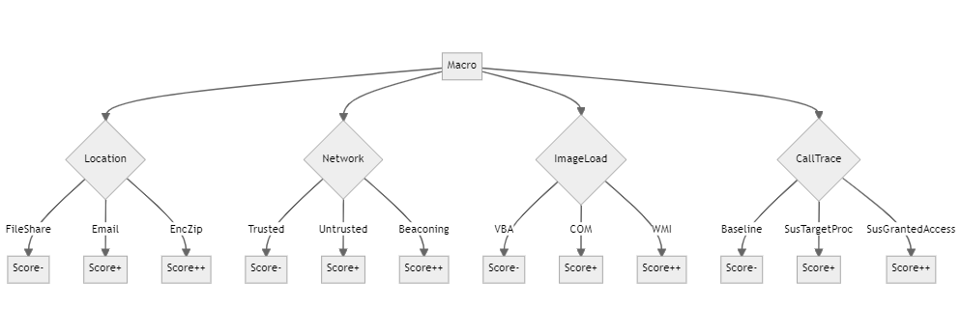
Notes:
- Looking at isolated events is great, and by now we hopefully have a better feel for what kind of telemetry is available to us in the context of Macros - now lets try to tie all this together into an alerting strategy – this should be somewhat easier now as we have visibility and baselining
The diagram you see here was made with Mermaid JS and the code for it is on the GitHub repo, please feel free to use it if you find it valuable and add your own alerting criteria
Please note that not every single factor was added here due to space constraints, but the basic idea is that we want to raise or lower some kind of score within our alerting paradigm – Alex Texirera has described this as “Hyper or Qualifier Queries”, but different vendors have different names for them
The main goal here though, is that you want to take a certain factor or behaviour, one that you can observe through your event logs and use it to either raise or lower a score, and after baselining, when that score moves past a threshold that you set, you investigate, run a playbook or what have you
In this example we are raising a score if certain conditions are met, like the macro coming from an encrypted zip, loading COM DLLs, generating abnormal Sysmon EID 10s or exhibiting beaconing behaviour

Slide 16
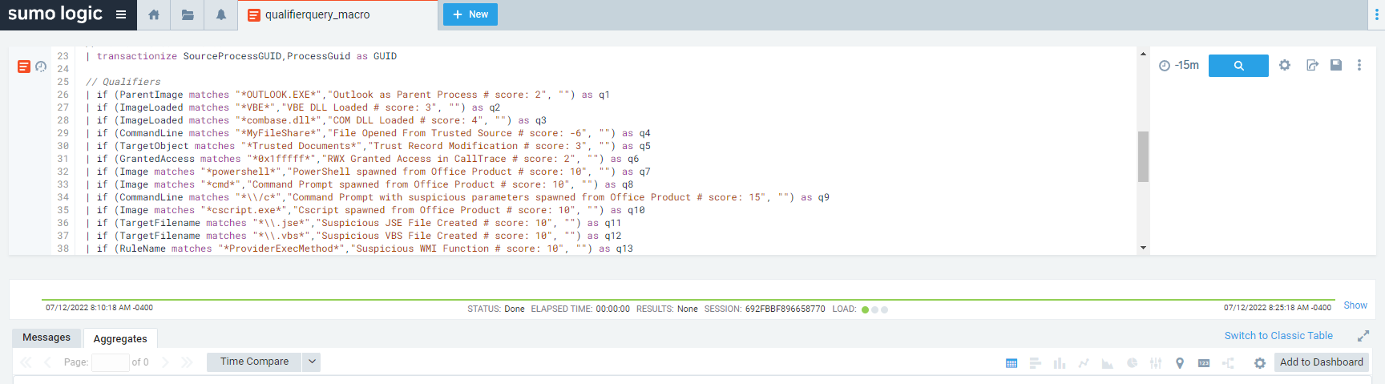
Hyper/Qualifier Queries
SIEM Hyper Queries: introduction, current detection methods (part I/II) | by Alex Teixeira | Medium
Notes:
Now we have our baselining completed and we have a good alerting strategy – we need the technical underpinnings and the actual query logic

Slide 17
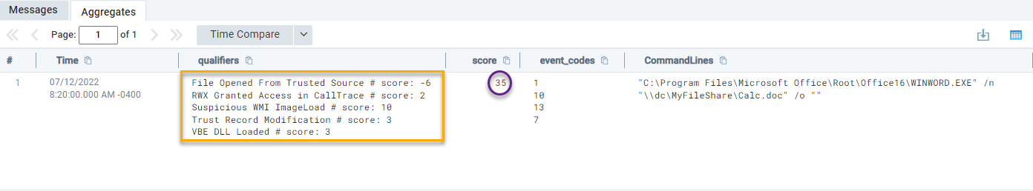
Baseline
Notes:
We can start with a quick baseline – in this case I am executing a macro from a file share that I already know users open macros from, in a legitimate fashion
This macro uses WMI and spawns a process, so it performs some suspicious behaviour, but the fact that it opens from a file share means that we can trust it just a little bit more – this doesn’t mean that we fully exclude it however, just lower our score when we see it
In this example, our baseline score is 35 points –I should also note that the “scoring” is totally arbitrary, you can set all this based on your own environment

Slide 18
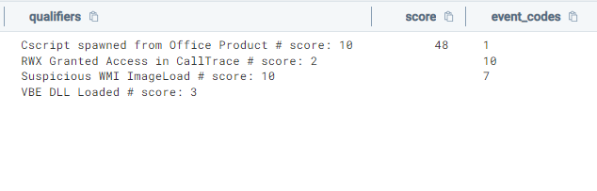
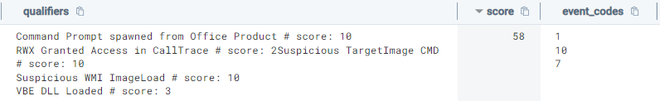
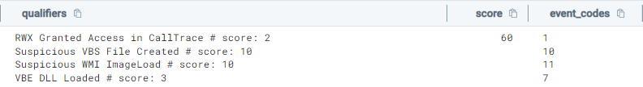
T1204.002 – Malicious File – Atomic Test 1
T1204.002 – Malicious File – Atomic Test 3
T1204.002 – Malicious File – Atomic Test 6
Notes:
Let’s compare our baseline macro to some red canary tests:
The first test is an “OS TAP” style macro execution – this scores at 48 – the score is higher here due to the macro containing a suspicious call trace, and spawning cscript
The second test is a “choice flag” execution, which scores at 58 – the score is higher here due to the command line switches as well as a command prompt being spawned from Word
The Third and final macro is an Excel 4 Macro, scoring at 60 – this scores higher due to a creation of a .vbs file and some suspicious call trace entries
All these macros are scoring at about double of our “baseline” macro – the actual scores and different techniques used in these particular macros matters less than the general dynamic of: you have a good baseline of what “normal” is in your environment, and you are alerting on things that deviate from that baseline

Slide 19
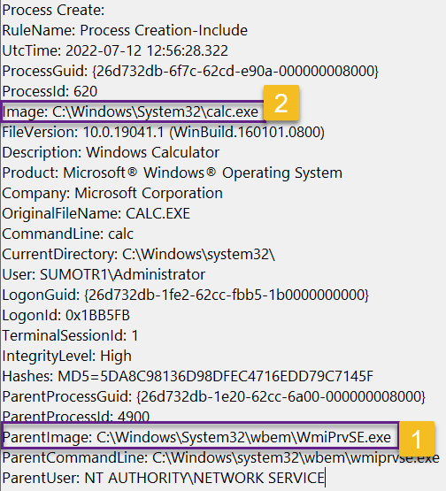
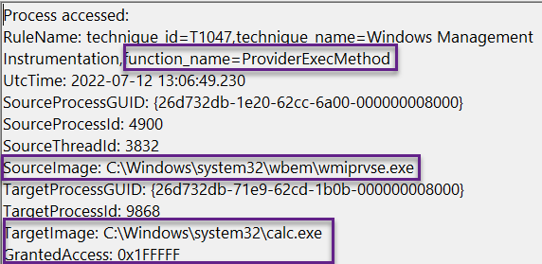
Watch out for WMI
ImageLoad
CallTrace
Functions
Notes:
WMI techniques are worth calling out specifically, they can be dangerous when it comes to macros, as they break parent/child process relationships and may confuse detection logic
However, DLL or ImageLoad events, combined with ProcessAccess events and a careful review of the call trace being generated when this type of tradecraft is used will bubble this activity up
The image on the left is showing WmiPRvSE spawning calculator and not WinWord – we can also see, on the right hand side, wmiprvse accessing the memory space of calc.exe with a suspicious function call – all this can be correlated back up to WinWord but the process tree will look different and will not show calc being spawned from WinWord

Slide 20
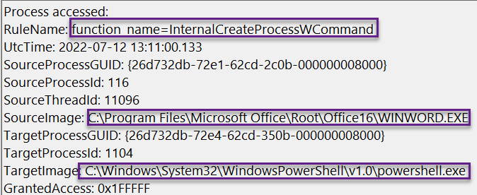
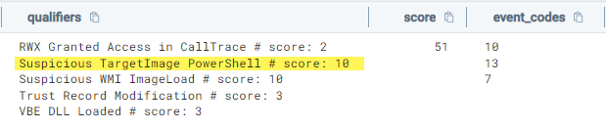
PPID Spoofing
Threat Actor goals: Explorer → PowerShell
NOT WinWord → PowerShell → Calc
Notes:
Similar to WMI, PPID spoofing aims to break the process relationship chain – the goal of this particular PPID spoofing macro is to make it look like PowerShell spawned from Explorer, not WinWord
If we look at Process Access events however, and look at the right function calls, we can see the “real” parent process of PowerShell, which in this case is WinWord, so if we see this mismatch between EID 10 and 1, it may be PPID spoofing
And of course, we can add all this logic to our qualifier query and score it appropriately

Slide 21
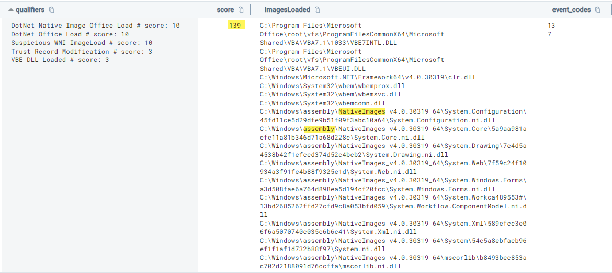
.NET – Gadget2Jscript
med0x2e/GadgetToJScript: A tool for generating .NET serialized gadgets that can trigger .NET assembly load/execution when deserialized using BinaryFormatter from JS/VBS/VBA based scripts. (github.com)
Notes:
.NET based macros can also be detected using the methods we have been outlining – so lets look at a few examples, starting with Gadget2Jscript
This is a really interesting technique – that, (and this is a very simplified explanation), makes it so you can load .NET assemblies from VBA code – I have personally executed this technique in various environments and have successfully seen it skirt around EDR and other controls HOWEVER …
With the right visibility in place, we can see our qualifier query lighting up very brightly, with a significant score of 139 – compared to a score of 35 for our baseline macro – this is due to the various suspicious native image loads and assembly loads as we can see in the screenshot on the slide

Slide 22
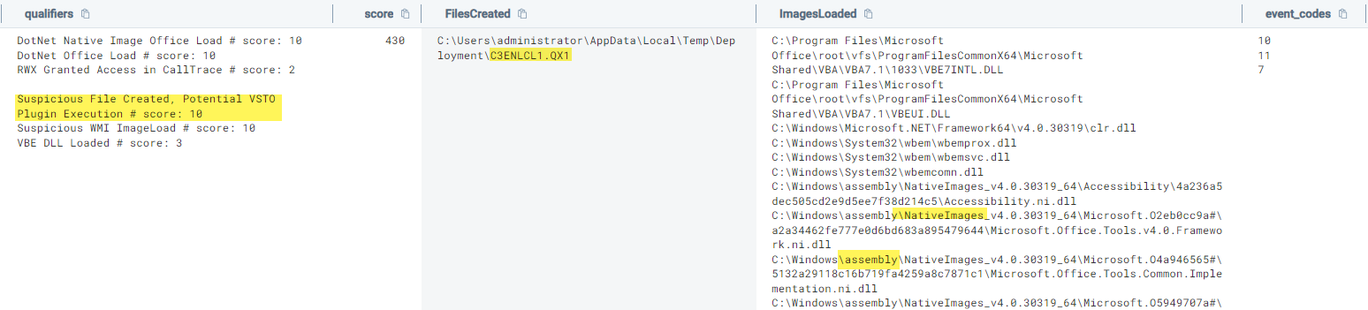
.NET – VSTO
Make phishing great again. VSTO office files are the new macro nightmare? | by Daniel Schell | Medium
VSTODetectionNotes.md (github.com)
Notes:
A lot is happening under the hood with VSTO plugin execution, Daniel Schell has an excellent write up that I highly recommend you check out that is linked at the bottom of this slide
From a detection standpoint, in addition to loading a bunch of .NET DLLs, VSTO plugin execution also drops a suspicious file, which is what the screenshot here is showing, and we can see the file being dropped in the middle column, with an QX1 extension
We can include all this behavior in both our Sysmon configs and qualifier queries
If you’re interested in exploring more telemetry from this VSTO write up, check out my Git gist linked below as well

Slide 23
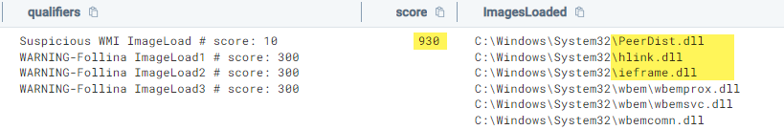
0Days
Zero Day does not mean you are totally blind
Keys to success:
Telemetry Generated
Telemetry Available
Telemetry flexibility
Baselined behavior
Alerting strategies
Follina - CVE-2022-30190 | Sumo Logic
Notes:
Just because an Office ZeroDay is out there does not mean that you are totally blind, in my experience the following factors greatly help when dealing with a 0day, especially in something like an office product
The relevant telemetry needs to be generated – in our examples this means a good working Sysmon config installed on hosts where Office is – more concretely, this also means looking at events that go beyond your standard process creation events, especially when dealing with more advanced Office macro tradecraft
The relevant telemetry needs to be available – that is, the telemetry needs to be found in a SIEM or log analytics platform that allows you to slice and dice the data and build queries, particularly more “advanced” data crunching like hyper / qualifier or risk-based queries
The telemetry needs to be flexible. For example, if you test VSTO tradecraft and see that a file creation event needs to be added to your Sysmon config to generate the right logs, how quickly can this be rolled out to your fleet?
Normal behavior needs to baselined – this means that you generally understand who uses macros, where are they used from etc
And finally, a good alerting strategy needs to be in place – I want to argue here that the standard alerting strategy of “Office product spawned X process, or did Y thing” is probably not going to be enough for the more advanced macro tradecraft – I strongly urge the collection and analysis of more telemetry aimed at Office
if you are watching this presentation and are thinking: ”Okay, Sysmon telemetry is cool but what about my EDR” – I would urge you to play around with some benign but maliciously-behaving macros, in combination with the OfficeSus Sysmon config, and compare what you are seeing with Sysmon versus what you are seeing with your EDR

Slide 24
More Alerting Ideas
First-run macro for a user
Office beaconing AND/OR Office making multiple network connections
Office DNS Requests
Office calling out to Azure (Blob, CDN, Azure Public IP)
Macro downloaded from untrusted SharePoint / Google Drive
SOAR Action → https://github.com/decalage2/ViperMonkey
Notes:
We covered a lot of alerting strategies here including Image Loads, Process Trees, Call Traces etc however, with the rich telemetry that you will (hopefully) gain after watching this talk, we can do so much more, a few ideas:
Is this the first time that a user ran this macro ? This can be used in deciding whether a macro is malicious or not
Beaconing alerts at the proxy level are often tricky, however, if you have telemetry that ties a process to a network connection, beaconing detections are more feasible (Think Sysmon Event ID 3 here) -- Office products – other than telemetry – usually do not exhibit beaconing behavior
DNS requests made by Office products are a goldmine for detection efforts and leave threat actors with very little wiggle room in terms of obfuscation, these can be used in your qualifiers as well
I would urge you to take a very close look at where Office products are connecting to – they may connect to a lot of Microsoft-owned IP addresses – but typically do not connect to things like Azure blob storage, OneDrive, SharePoint or Azure Public IP addresses (your milage may vary here)
Macros or zips containing macros downloaded from Google Drive and untrusted SharePoint sites should be treated with extreme caution – a great exercise for defensive teams is to download benign macros from these sites and see if your telemetry allows you to rebuild where a particular macro came from and what that macro does – try this with both macros in zips, macros in ISO files and “raw” macros
Due to time constraints, I didn’t have much of a chance to talk about the amazing response tools that exist in the context of Office Macros – things like Velociraptor and the tools made by decalage2 are very powerful in terms of response and allow you to really dig into macro internals from a DFIR standpoint – an awesome SOAR playbook would be to take every macro executed in your environment, run it through ViperMonkey and pipe the results back into your SIEM for further analysis

Slide 25
Wrapping Up
Activities happen “before” and “after” a malicious macro execution
Even if macros are disabled tomorrow, the visibility effort it worth it
Go beyond process creation events
Macro tradecraft runs deep, strongly consider hardening steps
Notes:
And finally, to wrap things up …
Remember that a malicious macro executing in the environment is just one aspect of the “kill chain” – the phishing email had to land in a mailbox, and the macro must do something after it is executed, with a threat actor performing subsequent actions – these are all detection opportunities, in addition to detecting the malicious macro itself
Building a good telemetry and detection pipeline is difficult, involves a lot of engineering effort and people hours, combined with a specialized skill set – however, even if macros are disabled by default tomorrow, I would argue that this effort is still worth it, Office will always be an attractive and large attack surface
As we’ve ( hopefully ) seen with the examples presented here, we can get a lot of information from process creation events, particularly process trees, however, you can do a lot more with file creation, image load and process access events
A lot of macro trade craft was crammed into this presentation; however, the macro tradecraft well runs very deep – if macro executions concern you, I would strongly suggest looking at various hardening options for your endpoints, and not just disabling of macros, but the introduction of deny-by-default application control as well

